Slide 1

Customer Segmentation
By: Kimberly Cable
Notes:
Hi my name is Kimberly and today we are going to talk about Customer Segmentation using RFM Analysis and K means clustering.
Olist is a Brazilian e-commerce company that connects small businesses to a larger marketplace. It gives these small businesses a way to manage their products, shipping, and online payments. They have approximately 200,000 users in about 180 countries.
This study looks into finding similar traits among its customers which will help the marketing team know who best to send offers to or to whom might they need to send a discount coupon because it looks like they haven’t purchased in a while.

Slide 2

Datasets
Customers: This dataset has information about the customer and their location.
Geolocation: This dataset has information about the Brazilian zip codes and their latitude/longitude coordinates.
Order Items: This dataset has information about the items purchased within each order.
Order Reviews: This dataset has information about the reviews made by the customers.
Order Payments: This dataset has information about the order payment options.
Orders: This dataset has information about all customer orders.
Products: This dataset has information about all the products sold by Olist.
Sellers: This dataset has information about the sellers that fulfilled the orders made at Olist.
Notes:
Olist’s data consists of 8 datasets. The datasets I will be looking into are the Orders, Order Items, and Order Reviews to get a better understanding of the customers.

Slide 3
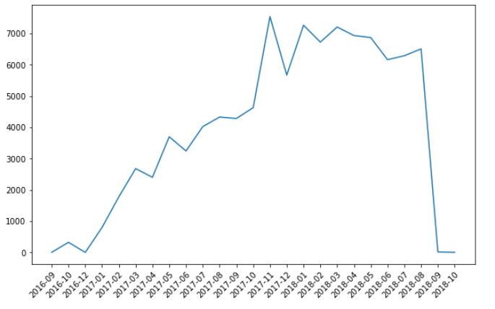
Data Cleaning
Orders between Jan 2017 – Aug 2018
Notes:
Looking at the orders dataset, you can see orders in 2016 and after August 2018 were significantly lower than those orders that were purchased between Jan of 2017 and August of 2018 so those orders were dropped from the dataset.
We will only be using orders between Jan of 2017 and August 2018.

Slide 4
Data Cleaning – Empty Values
Order Approved At
Order Delivered Customer Date
Order Status = Delivered
Order purchase timestamp was used
Order Status = Delivered
Median (order delivered date - order carrier date)
+ carrier delivered customer date
Order Delivered Carrier Date
Order Status = Delivered
Order Approved At date was used
Notes:
Because we will be looking at approved and delivery dates, I needed to address the empty values for those orders that had an Order Status of delivered.
For the order approved at date, I replaced the empty values with the order purchase timestamp
For the order delivered carrier date, I replaced those empty values with the order approved at date
For the order delivered customer date, I took the median of the difference between the order delivered date and the order carrier date. This was a value of 7 days. I then added this to the carrier delivered customer date to get the new order delivered customer date.

Slide 5

Exploratory Data Analysis
Notes:
Now we will look into what the data is telling us

Slide 6
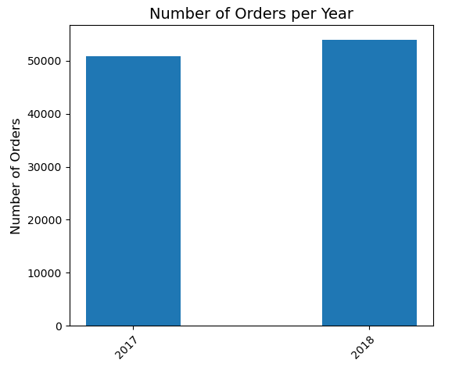
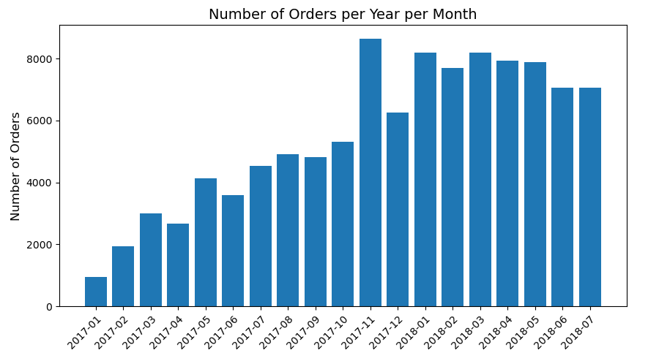
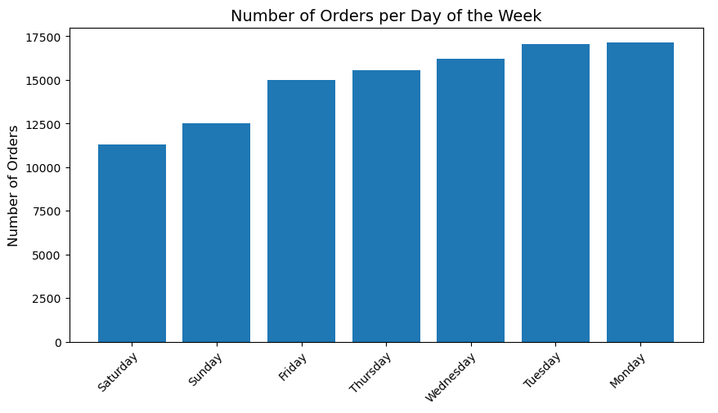
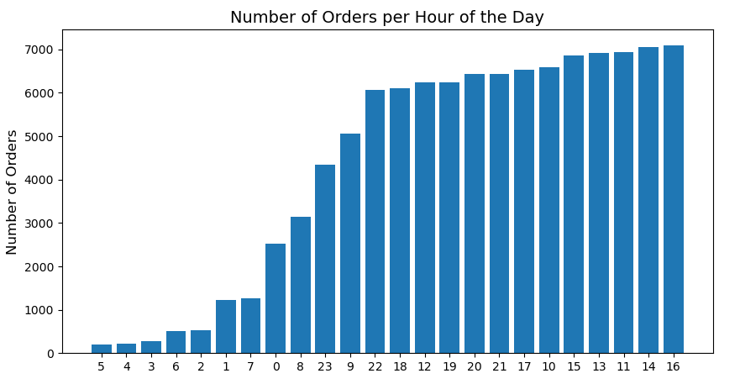
Orders
Notes:
Looking at customer orders:
The number of orders grew between 2017 to 2018.
November and January had the highest number of orders probably due to the holidays and holiday gift cards.
March, April, and May were also good months.
Weekdays seemed more popular as the beginning of the week and early evenings were best probably due to items needed from the weekend.

Slide 7
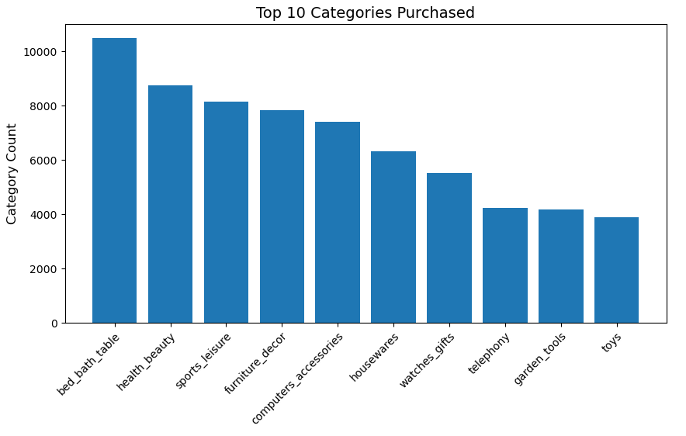
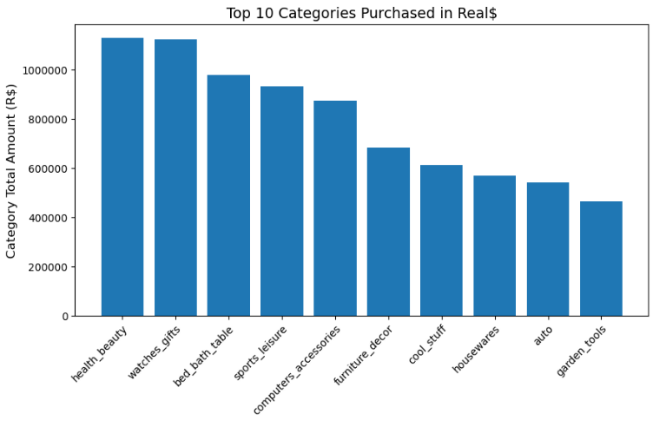
Categories
Notes:
Most items that were purchased were from the Bed, Bath & Table category but the top category in the amount purchased was Health & Beauty.
Most customers purchased items in the bedroom/bathroom area or that were used in the bedroom/bathroom area.

Slide 8
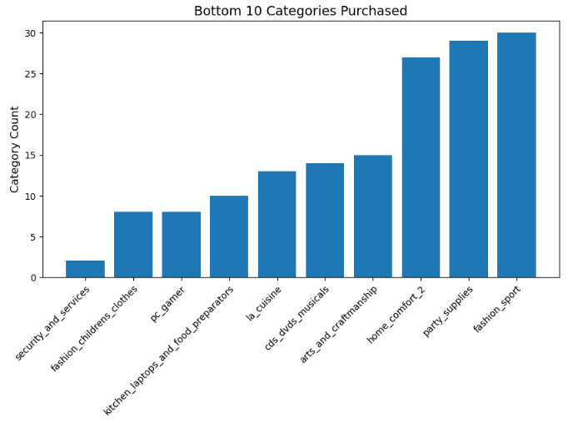
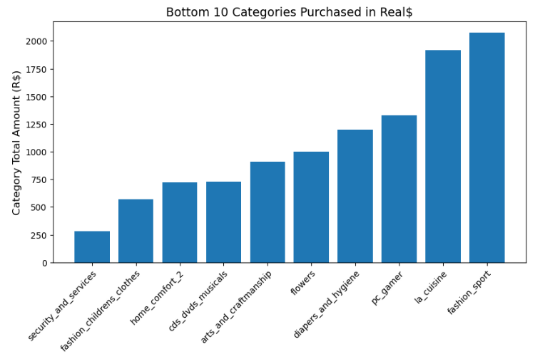
Categories (cont.)
Notes:
Looking at both the number of items purchased, and the amount spent, the Security and Services and Children’s clothes categories are at the bottom.
It could be that there are not many sellers of these items or more marketing needs to be allotted for these bottom categories.

Slide 9
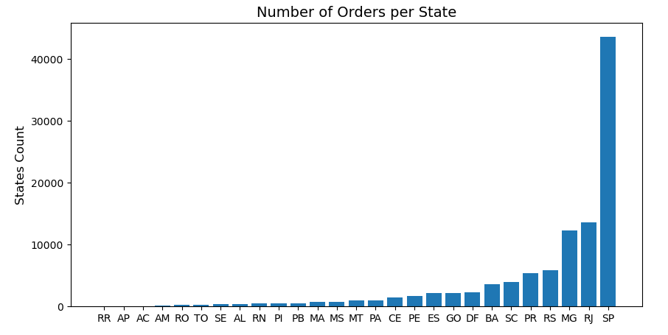
States
Notes:
The top State was São Paulo by far compared to the other States in Brazil. Marketing may investigate advertising more in States other than São Paulo.

Slide 10
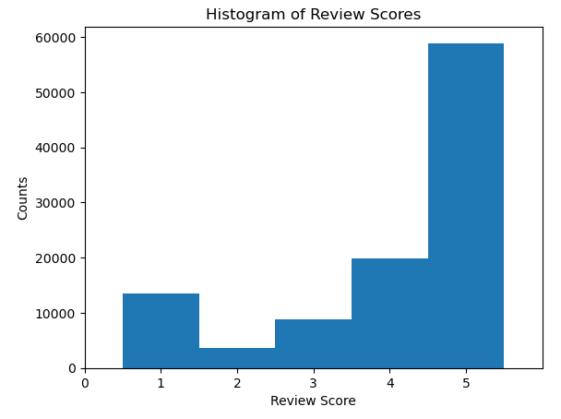
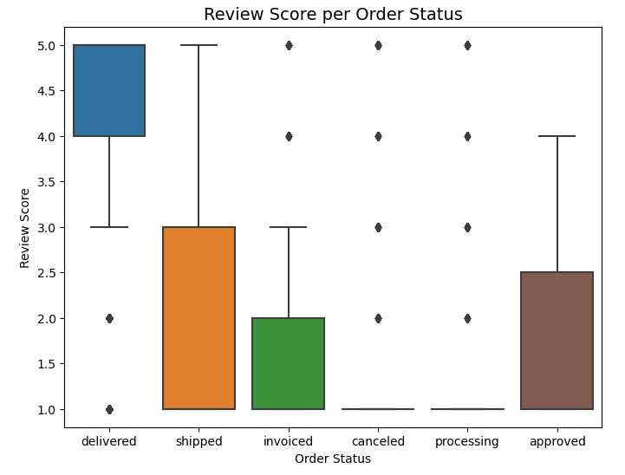
Review Score
Notes:
Looking at the review score, for those orders that were delivered a score of 5 was given far more than the other order status’

Slide 11
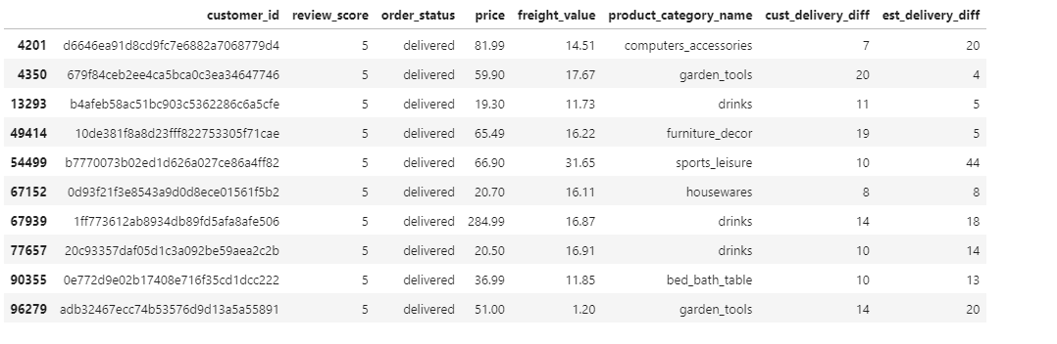
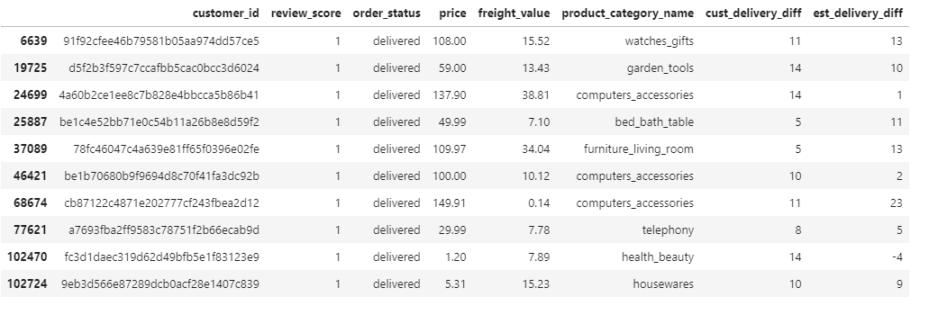
Review Score = 5
Customers
Review Score = 1
Notes:
I wanted to see how customers who gave a review score of 5 compared to customers that gave a poor review score of 1.
Looking at the difference in the actual customer delivery date to the estimated delivery date I could really see anything significant
Same goes with the price of the order or the cost of shipping

Slide 12
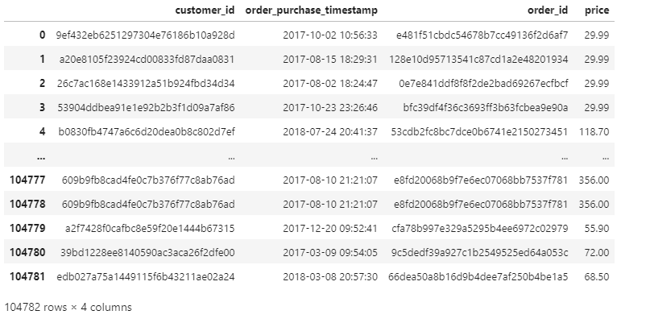
Final Dataset for Modeling
Notes:
Now that we’ve looked at the data, we will now look more closely at customer segmentation using Recency, Frequency, and Monetary Analysis and K-Means Clustering.
The data we will use will consist of when a customer order was purchased and the total amount.

Slide 13
Modeling
Notes:
Let now look at our modeling methods

Slide 14
RFM Analysis + K-Means Clustering
Recency, Frequency, and Monetary Analysis (RFM)
K-Means Clustering
Looks at historical customer behavior to predict how might a new customer act in the future
Grouping customers based on historical data according to how recently the purchased, how frequently they purchased and how much money they spent on purchases.
Recency:
How recently has a customer purchased?
Frequency:
How many orders did a customer purchase?
Monetary:
How much money has a customer spent?
Notes:
Recency, Frequency, and Monetary Analysis, or RFM is a look at historical customer behavior to predict how might a new customer act in the future.
Recency is how recently a customer last purchased from us.
Frequency is how many times a customers has purchased with us.
And Monetary is what is the total amount a customer has spent with us.
Once we find these values we will then take the data and use a K-means clustering method to help group the customers into different segments.
K-means clustering use historical data to group the data into different segments based on how similar the data is.

Slide 15
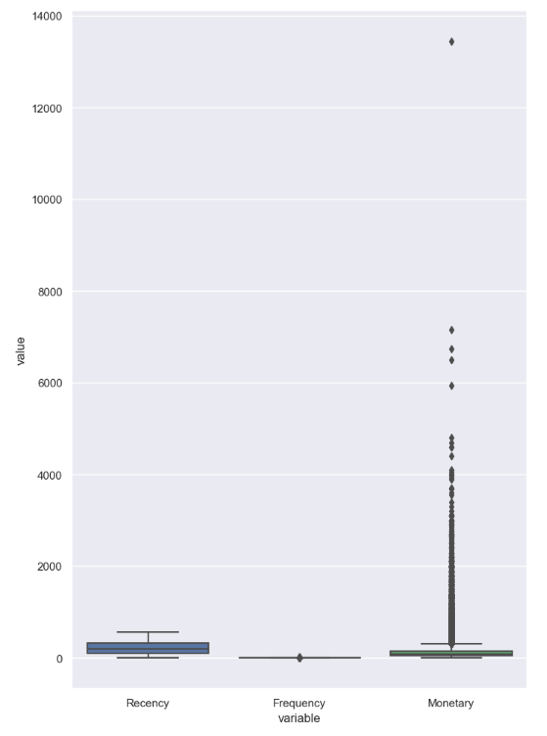
RFM Analysis
Recency
Mean: 256 days
Min: 0 days
Max: 572 days
Frequency
Mean: 1.12 times
Min: 1 time
Max: 22 times
Monetary Value
Mean: R$138
Min: R$0.85
Max: R$13,440
Notes:
After calculating the RFM analysis, I was able to find that the average customer last purchased from us about 256 days before the most current customer purchased from us. This indicated that many customers do not come back after making their initial purchase.
Most of the customers have only purchased 1 time which indicated that either they had a bad experience or no other items appealed to them to want to purchase again.
And the average customer spent $138 with customers ranging from spending only 85 cents to $13,440.
Since a majority of customers only purchased 1 time, I will not use the frequency data and concentrate our findings on how recently a customer purchased from us and how much they spent.

Slide 16
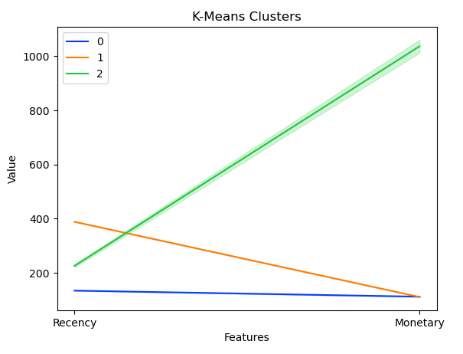
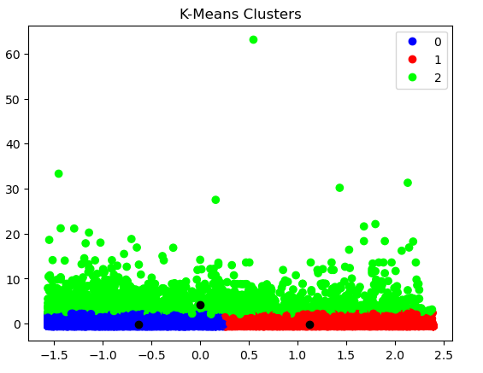
K-Means Analysis
Number of clusters: 3
Notes:
Using a silhouette analysis and the elbow method, it was determined that 3 was the optimal number of clusters for our recency and monetary data.
What we found were three distinct groups of customers for marketing.

Slide 17
Group 1
Customers that haven't purchased items in a long time and their purchases amount to a very low dollar amount.
Group 2
Customers that have purchased recently but purchases total to a very low dollar amount
Group 3
These are customers that have purchased items somewhat recently but these customers’ purchases amount to a very high dollar amount.
Notes:
Group1 customers were those that haven’t purchased from us in a long time and their purchase totals were very low. These customers may need incentives to come back.
Group 2 customers were those that have purchased from us recently but did not spend a lot of money on their purchases. These customers will need incentives to come back and maybe coupons for other items.
Lastly, Group 3 customers purchased fairly recently, and their purchase totals were very high. These customers will need incentives like coupons and targeted advertising on products that go with their recent purchases.

Slide 18
Thank you
Notes:
In this study, I looked at customer segmentation and used Recency, Frequency, and Monetary Analysis along with K-Means clustering analysis.
We found that there were 3 distinct customer segments to help the marketing team with targeting those customers with incentives and or coupons to entice them back and purchase more.
This should help with customer satisfaction and review scores being high.
Thank you

